Slide 1
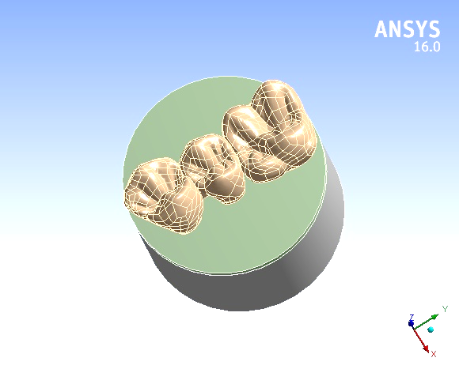
R1 - Zr PD + 110N vertical

Slide 2
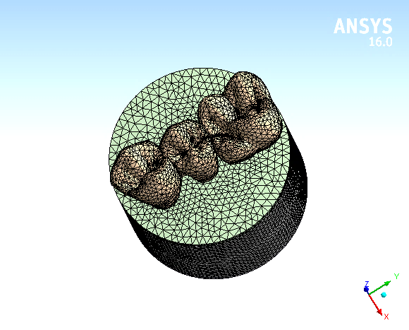
ALL mesh

Slide 3
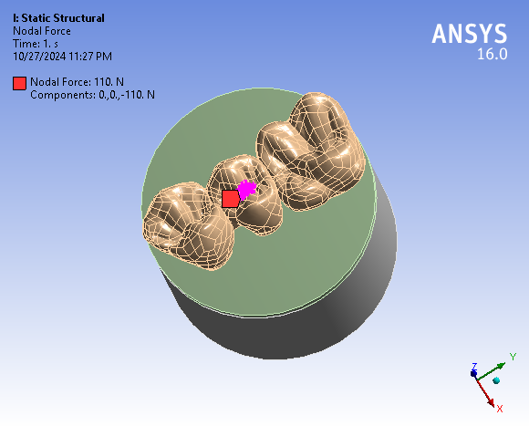
Load

Slide 4
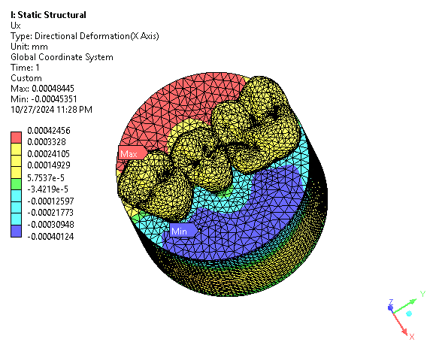
All - Ux

Slide 5
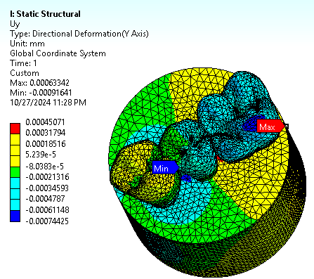
All - Uy

Slide 6
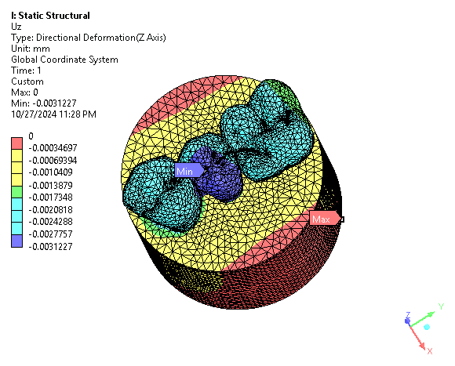
All - Uz

Slide 7
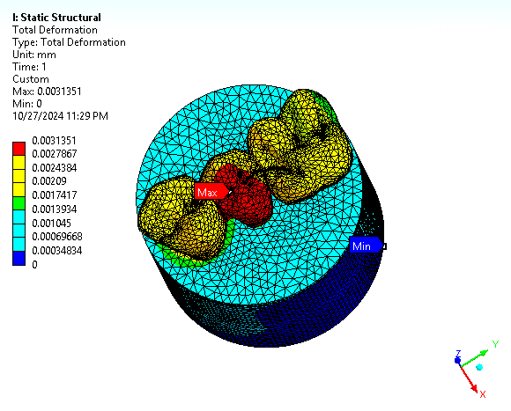
All - Ut

Slide 8
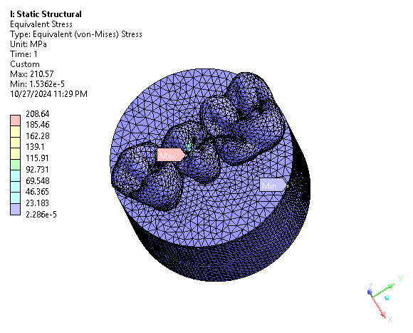
All - Svon

Slide 9
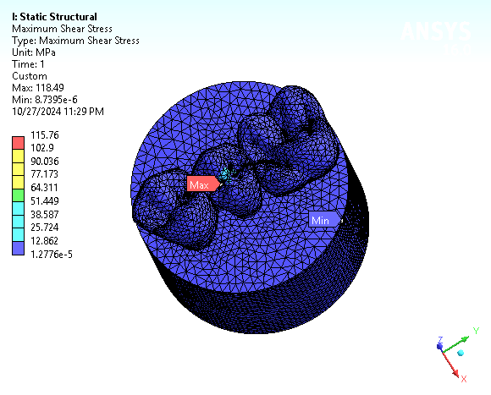
All – S shear

Slide 10
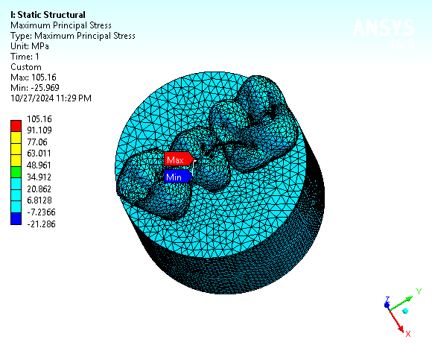
All – Smax Principal

Slide 11
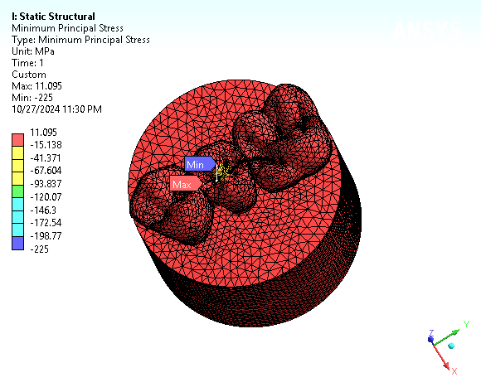
All – Smin Principal

Slide 12
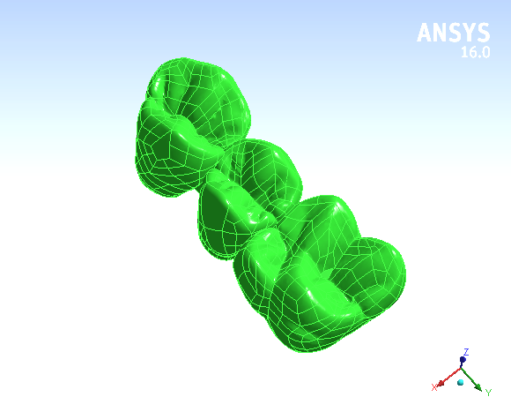
PD

Slide 13
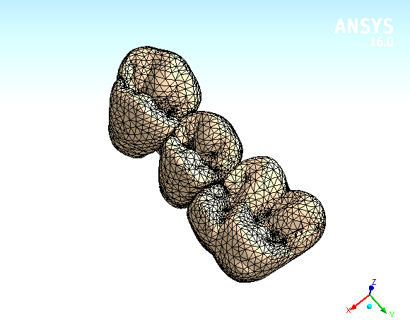
Mesh

Slide 14
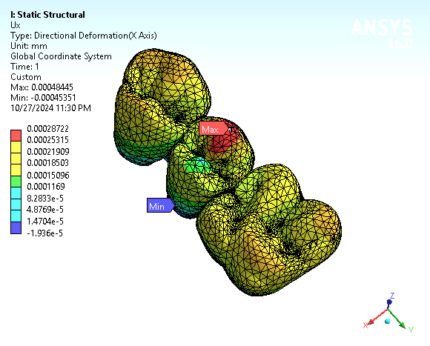
Ux

Slide 15
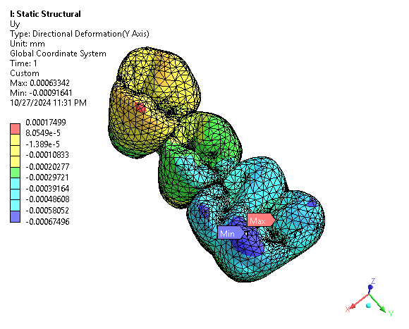
Uy

Slide 16
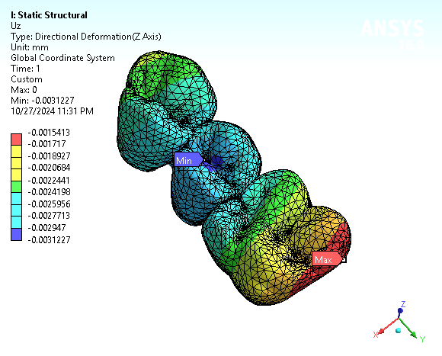
Uz

Slide 17
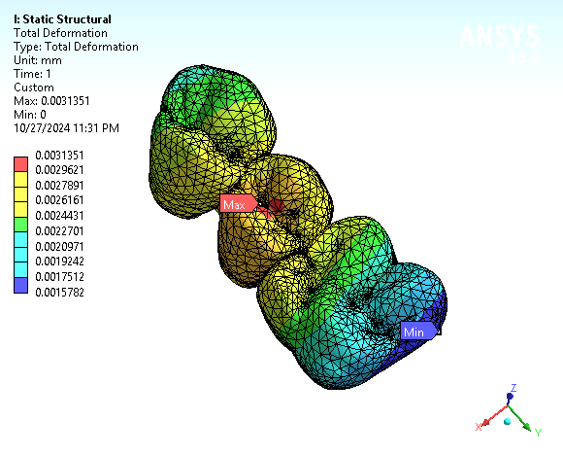
Ut

Slide 18
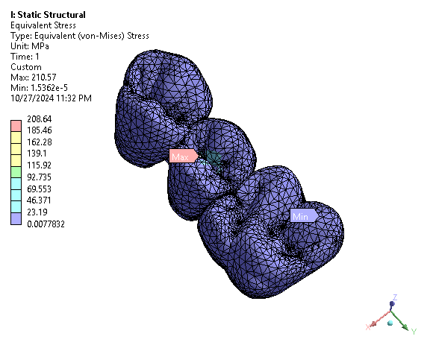
Svon

Slide 19
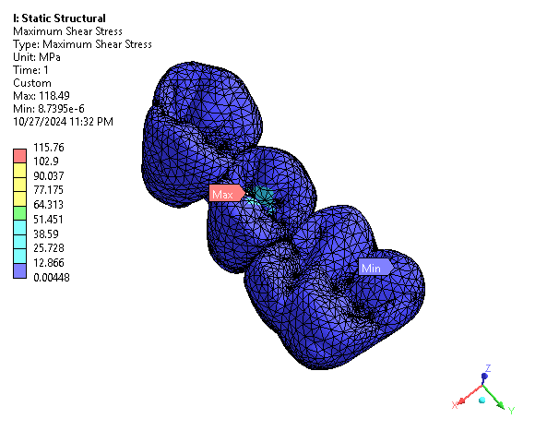
S shear

Slide 20
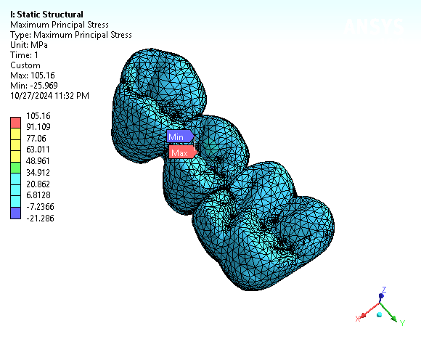
Smax Principal

Slide 21
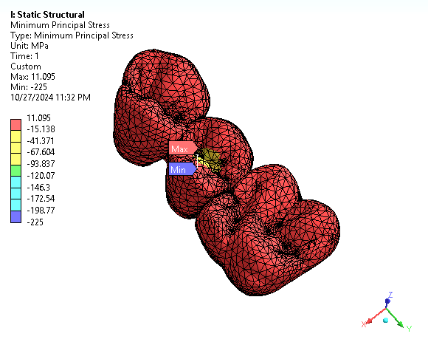
Smin Principal

Slide 22
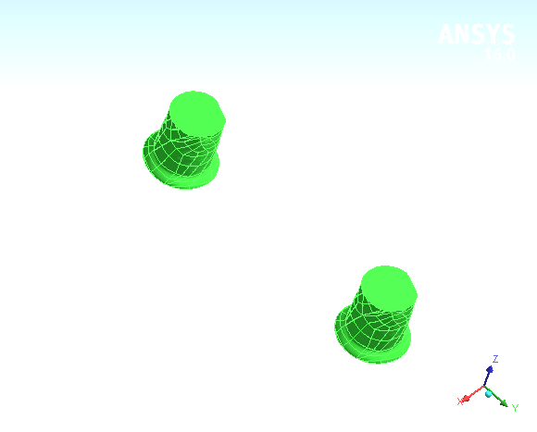
Cement

Slide 23
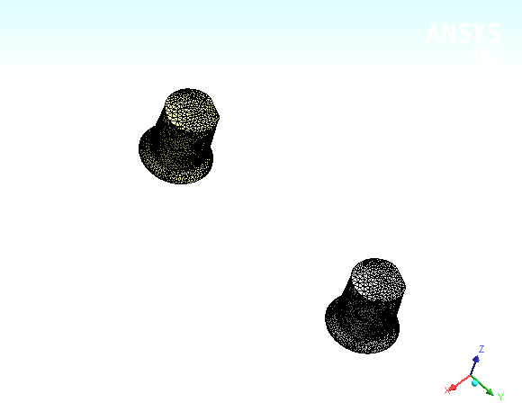
Mesh

Slide 24
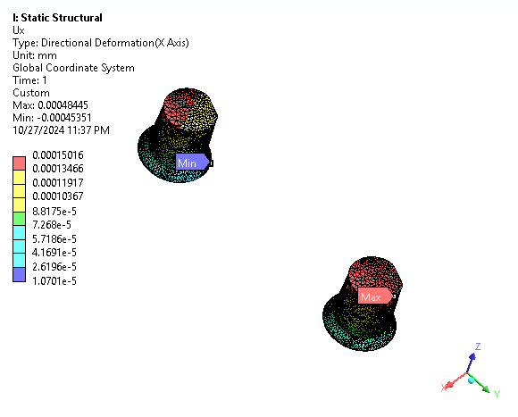
Ux

Slide 25
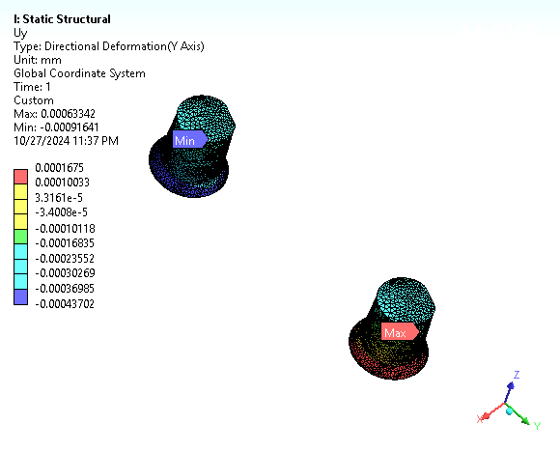
Uy

Slide 26
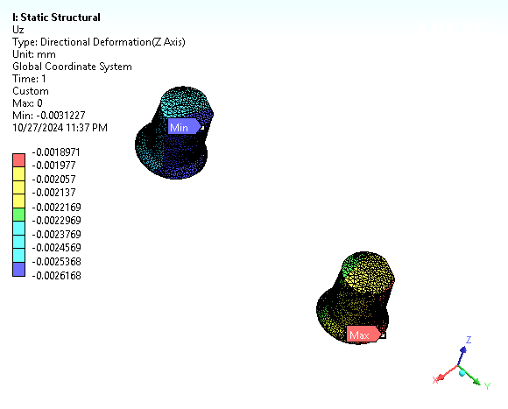
Uz

Slide 27
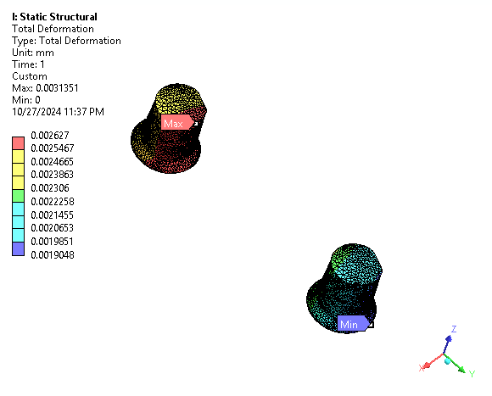
Ut

Slide 28
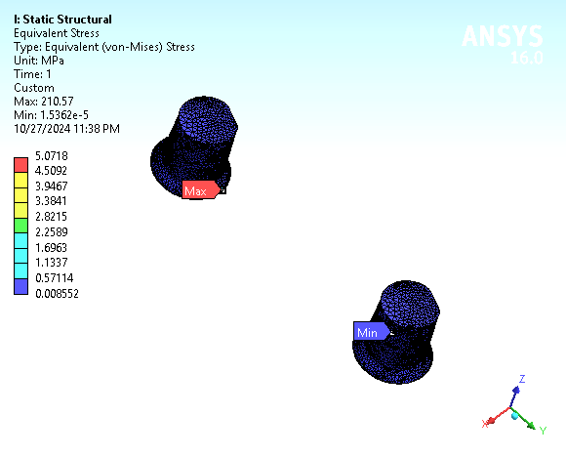
Svon

Slide 29
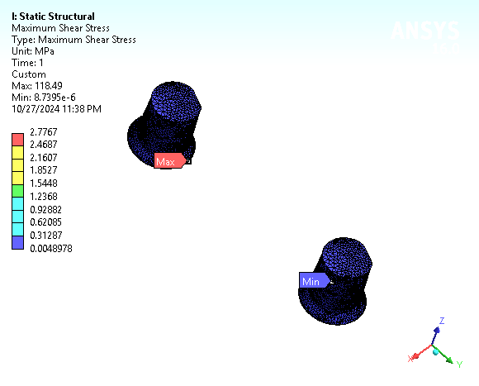
S shear

Slide 30
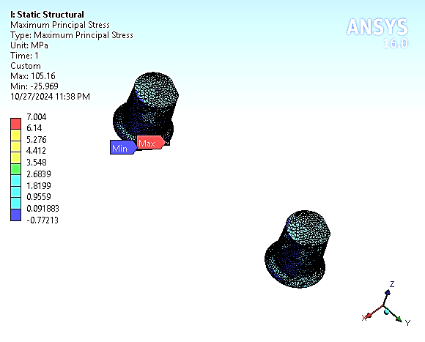
Smax Principal

Slide 31
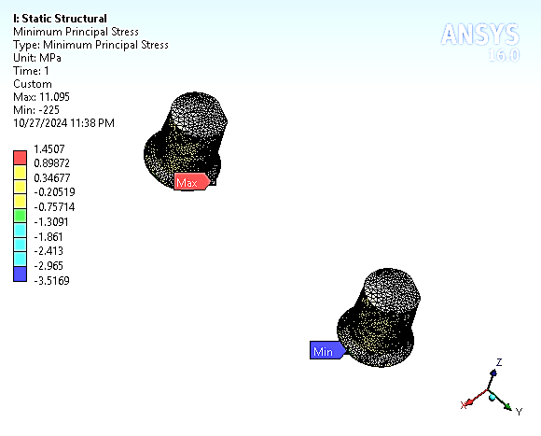
Smin Principal

Slide 32
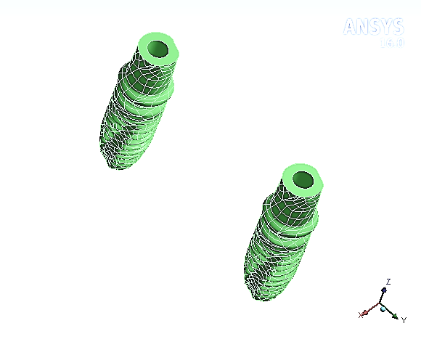
Implant complex

Slide 33
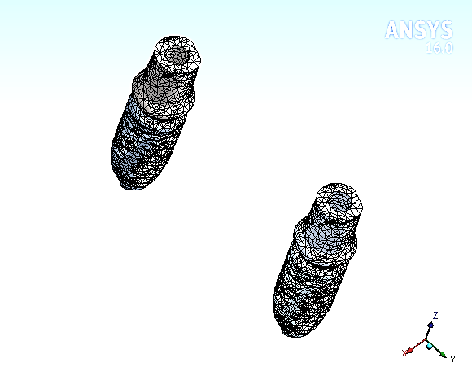
Mesh

Slide 34
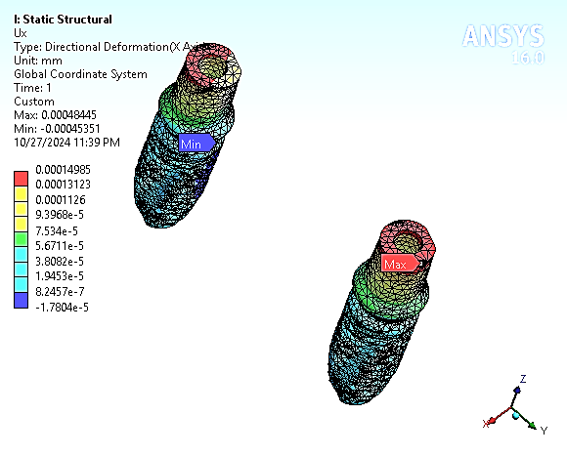
Ux

Slide 35
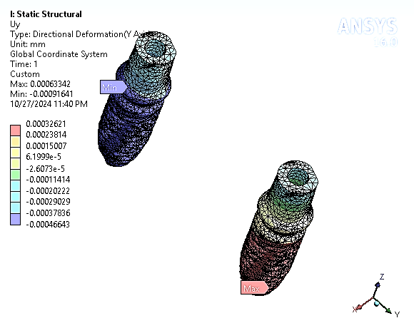
Uy

Slide 36
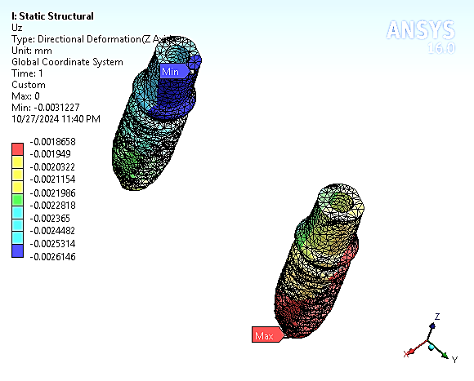
Uz

Slide 37
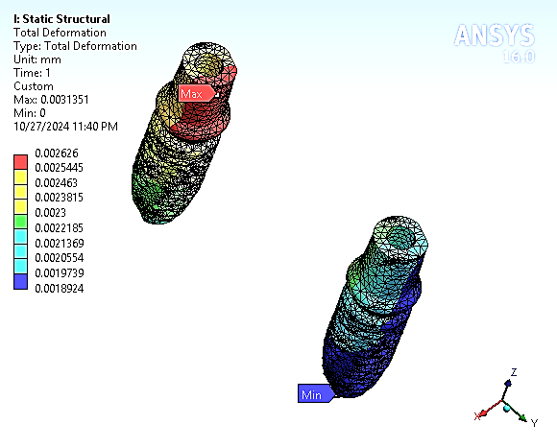
Ut

Slide 38
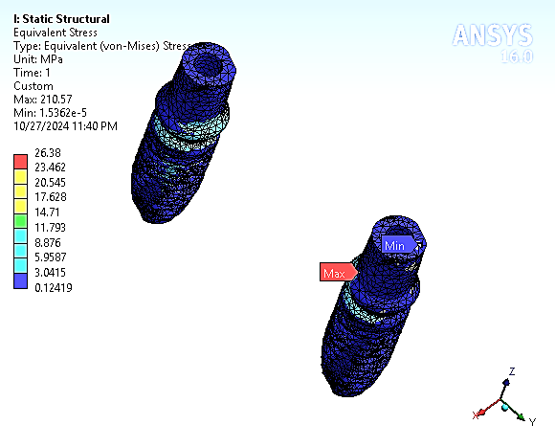
Svon

Slide 39

S shear

Slide 40
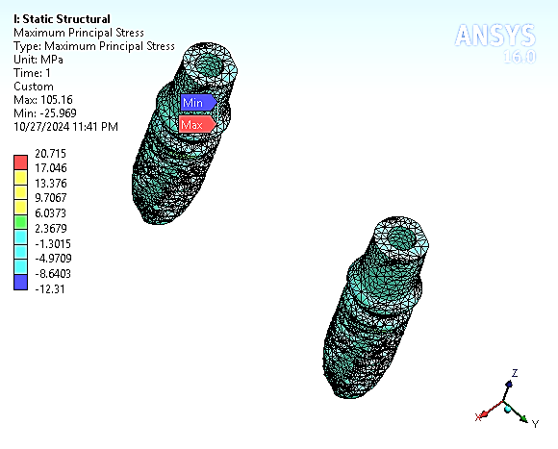
Smax Principal

Slide 41
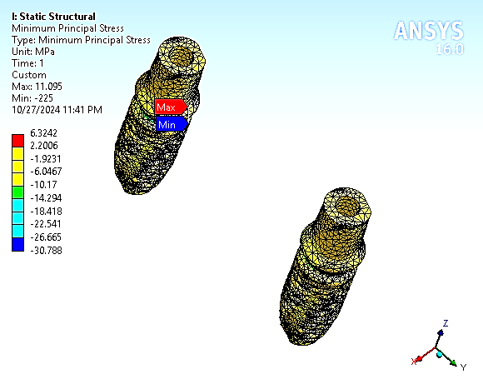
Smin Principal

Slide 42
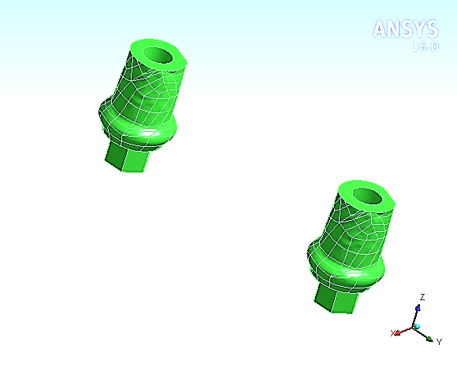
Abutment

Slide 43
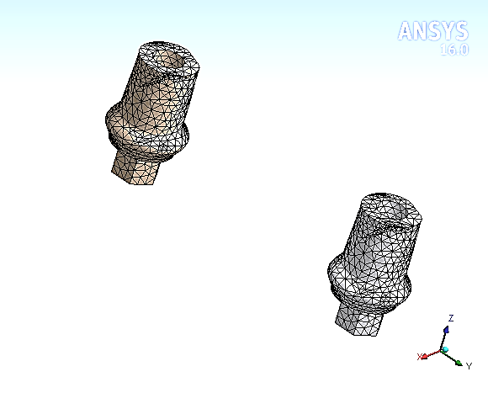
Mesh

Slide 44
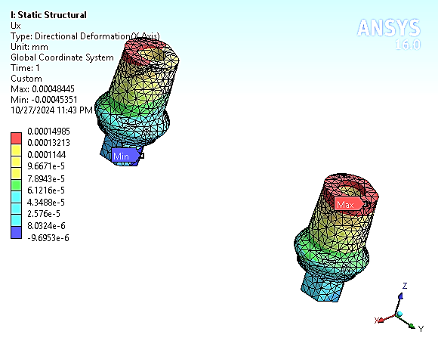
Ux

Slide 45
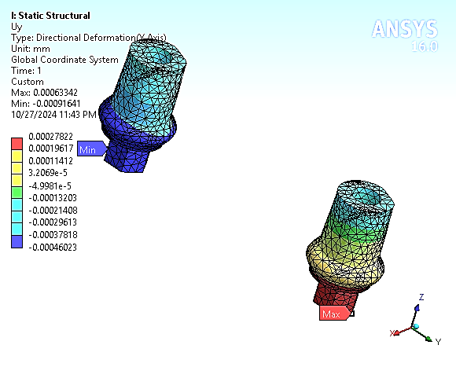
Uy

Slide 46
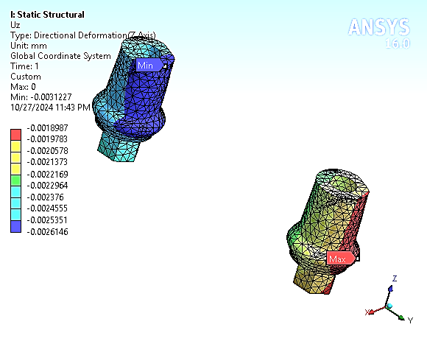
Uz

Slide 47
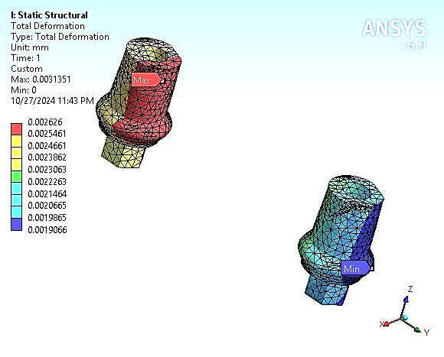
Ut

Slide 48
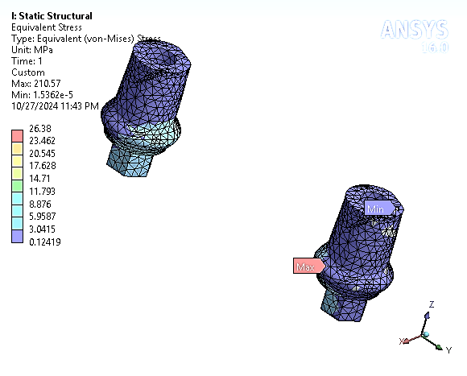
Svon

Slide 49

S shear

Slide 50
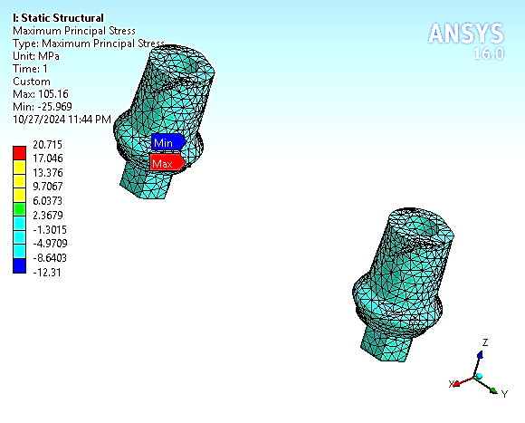
Smax Principal

Slide 51
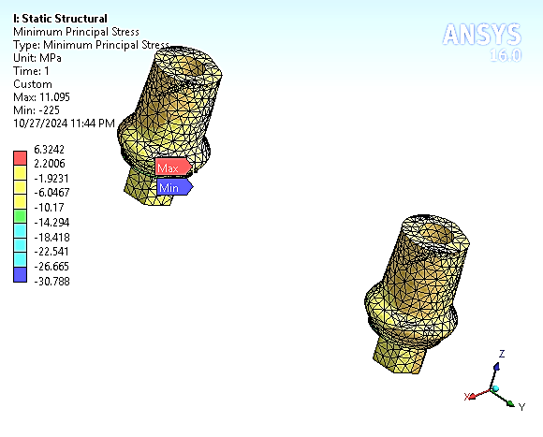
Smin Principal

Slide 52
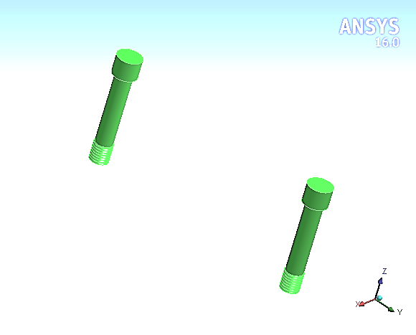
Screw

Slide 53

Mesh

Slide 54

Ux

Slide 55

Uy

Slide 56

Uz

Slide 57

Ut

Slide 58

Svon

Slide 59

S shear

Slide 60

Smax Principal

Slide 61

Smin Principal

Slide 62

Implant

Slide 63

Mesh

Slide 64

Ux

Slide 65

Uy

Slide 66

Uz

Slide 67

Ut

Slide 68

Svon

Slide 69

S shear

Slide 70

Smax Principal

Slide 71

Smin Principal

Slide 72

Mucosa

Slide 73

Mesh

Slide 74

Ux

Slide 75

Uy

Slide 76

Uz

Slide 77

Ut

Slide 78

Svon

Slide 79

S shear

Slide 80

Smax Principal

Slide 81

Smin Principal

Slide 82

Cortical

Slide 83

Mesh

Slide 84

Ux

Slide 85

Uy

Slide 86

Uz

Slide 87

Ut

Slide 88

Svon

Slide 89

S shear

Slide 90

Smax Principal

Slide 91

Smin Principal

Slide 92

Bone

Slide 93

Spongy

Slide 94

Mesh

Slide 95

Ux

Slide 96

Uy

Slide 97

Uz

Slide 98

Ut

Slide 99

Svon

Slide 100

S shear

Slide 101

Smax Principal

Slide 102

Smin Principal

